Slide 1

Presentation on
Micro-Credit Defaulter Loan
Presented By: Raveesh Bhat

Slide 2
Agenda
Introduction
Problem Statement
Problem Understanding
What Is Microcredit Loan?
Benefits of Microfinance Institutions and Microcredit Loans
Data Analysis & Model Building Flowchart
Exploratory Data Analysis Steps
Visualizations
Data Analysis Steps Done
Assumptions
Model Building
Hyper Parameter Tuning and Crating Final Model
ROC-AUC Curve
Saving the model and prediction results
Conclusion

Slide 3
Introduction
Credit defaulter risk is one of the most important risks to be managed by a financial institution. Without loan repayment there is no profit, hence the problem of credit defaulter risk management is relevant to all financial institutions involved in lending to individuals and legal entries. This is even more true with microcredit organizations who have only one product-loans.
A Microfinance Institution (MFI) is an organization that offers financial services to low-income populations. MFS becomes very useful when targeting especially the unbanked poor families living in remote areas with not much sources of income. The Microfinance services (MFS) provided by MFI are Group Loans, Agricultural Loans, Individual Business Loans and so on.
Many microfinance institutions (MFI), experts and donors are supporting the idea of using mobile financial services (MFS) which they feel are more convenient and efficient, and cost saving, than the traditional high-touch model used since long for the purpose of delivering microfinance services. Though, the MFI industry is primarily focusing on low-income families and are very useful in such areas, the implementation of MFS has been uneven with both significant challenges and successes.

Slide 4
Problem Statement
A client in Indonesian Telecom Industry is collaborating with an Microfinance Institution (MFI) to provide micro-credit on mobile balances to be paid back in 5 days. The Consumer is believed to be defaulter if he deviates from the path of paying back the loaned amount within the time duration of 5 days. In order to improve the selection of customers for the credit, the client wants some predictions that could help them in further investment and improvement in selection of customers.
In this project we need to build a model which can be used to predict in terms of a probability for each loan transaction, whether the customer will be paying back the loaned amount within 5 days of insurance of loan. In this case, Label ‘1’ indicates that the loan has been paid i.e., “non-defaulter”, while, Label ‘0’ indicates that the loan has not been paid i.e., “defaulter”.

Slide 5


Problem Understanding
The loan providing companies find it hard to give loans to the people due to their insufficient or non-existent credit history. Because of that, some consumers use it as their advantage by becoming a defaulter. Suppose you work for a consumer finance company which specialises in lending various types of loans to urban customers. You have to use EDA to analyse the patterns present in the data. This will ensure that the applicants are capable of repaying the loan are not rejected.
When the company receives a loan application, the company has to decide for loan approval based on the applicant’s profile. Two types of risks are associated with the bank’s decision:
If the applicant is likely to repay the loan, then not approving the loan results in a loss of business to the company
If the applicant is not likely to repay the loan, i.e. he/she is likely to default, then approving the loan may lead to a financial loss for the company.

Slide 6



What is Microcredit Loan?
Microcredit is a common form of microfinance that involves an extremely small loan given to an individual to help them become self-employed or grow a small business. These borrowers tend to be low-income individuals, especially from less developed countries (LDCs). Microcredit is also known as “microlending” or “microloan”.
It aims to support and kickstart entrepreneurs who are unable to obtain the financial backing needed to start a small business or capitalize on an idea.
Defaulting on Loans:
Defaulting on a loan essentially means you've stopped making payments on a loan or credit card according to the account's terms. In general, defaulting on a loan can damage your credit and threaten your overall financial health.

Slide 7
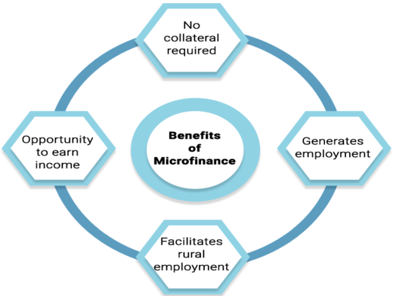
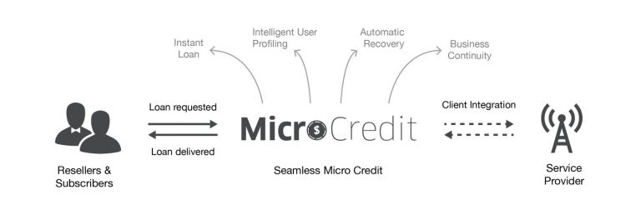
Benefits of Microfinance Institutions and Microcredit loans
Microfinance institutions offer basic financial services like savings, insurance and loans to unprivileged people. Savings help families build assets to finance school fees, improve homes (e.g., install power or running water) and achieve goals.
Small loans enable entrepreneurs to start or expand micro, small and medium enterprises.
Insurance products can offset the cost of medical care.
Microcredit also empowers women since they are the major beneficiaries.
Microcredit provides property alleviation programs which provides funds, materials for people with no income or work opportunities

Slide 8
Data Analysis and Model Building Flowchart
Import Libraries
Import Dataset
Data Preprocessing
Data Balancing
Identifying Outliers and Skewness
Visualizations
(EDA)
Model Building
Hyperparameter Tuning
AUC-ROC Curve & Saving model

Slide 9
Exploratory Data Analysis (EDA) Steps
Importing necessary libraries and importing dataset as a data frame.
Checked some statistical information like shape, number of unique values present, info, finding zero values etc.
Dropped some columns containing more than 90% of zero values assuming they won’t create skewness in later part.
Dataset was free from null values that is I found no missing values.
Extracted Day, Month and Year features from pdate column.
Found some negative/invalid values while checking the statistical summary of the dataset so, converted them into positive by using absolute command.
Visualizing the features using univariate and bivariate analysis. Univariate analysis is the simplest form of analysing the data. “Uni” means “one”, visualizing the data using one variable. Bivariate analysis is another form of analysing the data. “Bi” means “two”, visualizing the data using 2 variables.

Slide 10
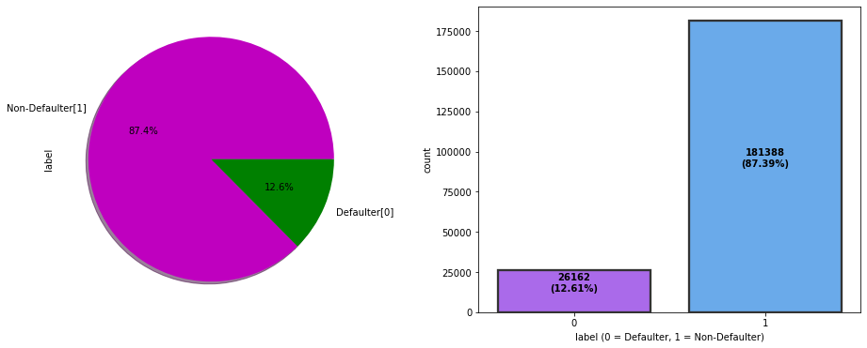
Visualizations: Univariate Analysis
Target Variable: Visualizing label whether the user paid back the credit amount within 5 days of issuing the loan or not {1:success, 0:failure}
From the above plots we can observe around 87% of the loan has been paid by the user and only 12% of the loan failed to pay. Also the dataset is highly imbalanced, so we need to work on that or else our model will be more biased towards success and make false interpretation.

Slide 11
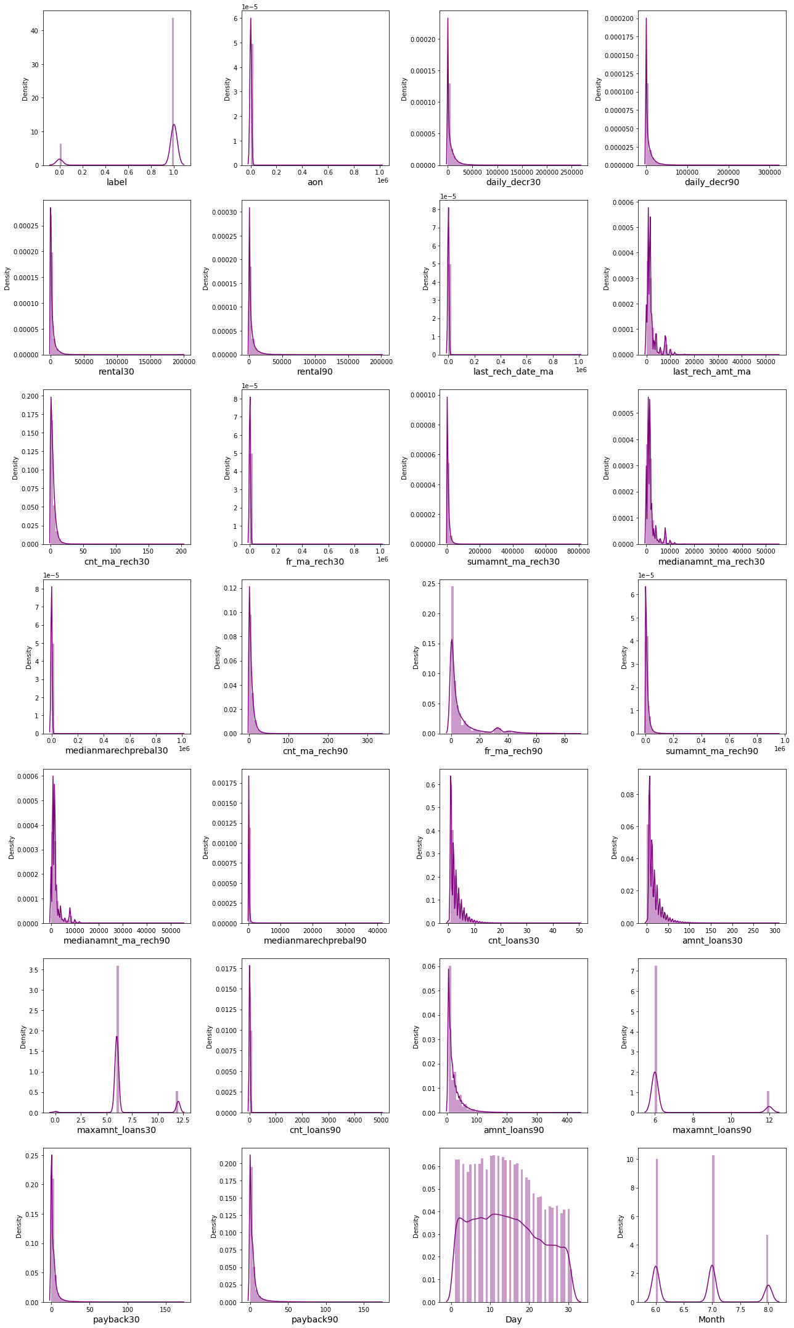
Visualizations: Univariate Analysis
Observations:
From the distribution plot, I can observe most of the columns are not normally distributed only Day column somewhat distributed normally.
All the columns have skewness and are skewed to right since the mean is greater than the median in these columns. We need to remove this skewness before building our machine learning models.

Slide 12
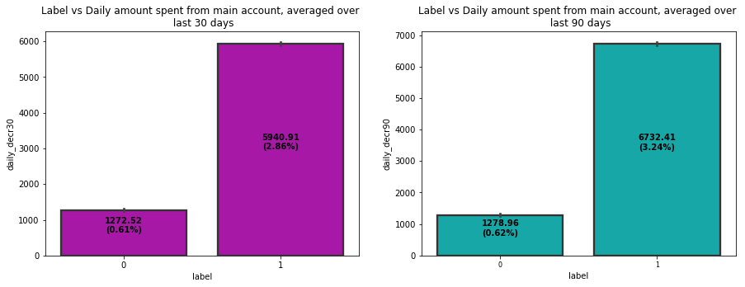
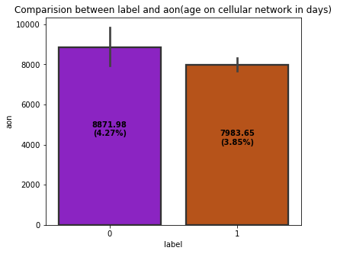
Visualizations: Bivariate Analysis
From the above bar plot we can observe that the defaulter rate is higher where the user age on cellular network in days is high which has around 8871 counts (in days).
Most of the users who have paid back the credit amount within 5 days of issuing loan, they have high rate of daily amount spent from the account over last 30 days and 90 days which have the count around 5940 and 6732 respectively.
The users who have spent daily amount from main account over last 30 days and 90 days have always paid back the loan amount within 5 days. Around 0.6% of the users failed to pay back the loan within due date.

Slide 13
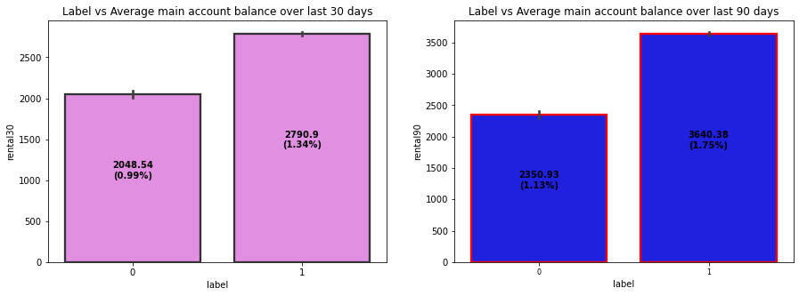
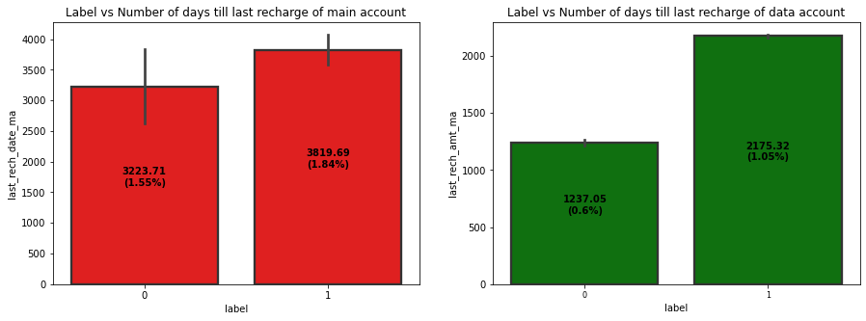
Visualizations: Bivariate Analysis
Non defaulter users have average main account balance over last 30 days and 90 days which have count around 2790 & 3640 compared to defaulter.
That means the users who have average main account balance always pays back the credit amounts within 5 days. And around 1% of the users either failed to payback the loan amount within the due date or they are not paying the loan.
The users who have recharged their main account on time are most likely to pay back their loan amount within 5 days. Also some of the users who have not paid back their loan within 5 days they also recharged their main account on time.
Looking at above plot of last_rech_amt_ma, we can say that if the amount of last recharge of main account is around 2000 then a greater number of people will pay back the loan amount.

Slide 14
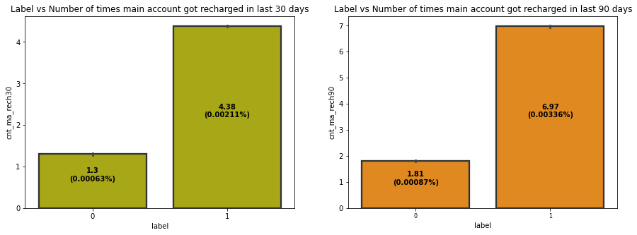
Visualizations: Bivariate Analysis
The non defaulters got recharged their main account more than 4 times in last 30 days and defaulters used to recharge their main account 1 time.
The users who have paid back their loan within 5 days have got recharged their main account up to 7 times in last 90 days and the users who have not been paid loan within due date, they have got recharged their main account twice in last 90 days.
From both the plots we can say that the users who got recharged their main account maximum times, they are able to pay back their loan amount within 5 days compared to the users who got their main account recharged less than 2 times.

Slide 15
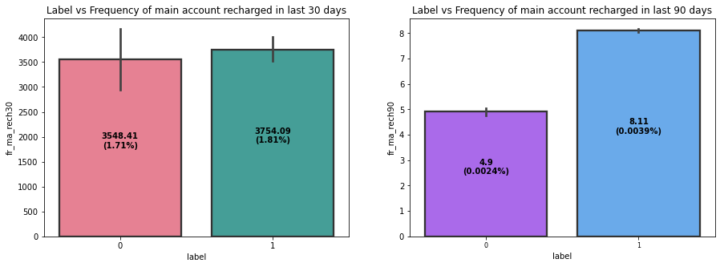
Visualizations: Bivariate Analysis
The count of defaulters and non-defaulters is almost similar for the frequency of main account recharged in last 30 days. They didn't pay back the loan within 5 days. Which means there it is not contributing more for prediction.
The frequency of main account recharged in last 90 days is increased for non-defaulters compared to defaulters.
From the frequency of main account recharged in last 30 days & 90 days we have seen the users with low frequency are causing huge losses, company should implement some kind of strategies to reduce that like send SMS alerts for notification.

Slide 16
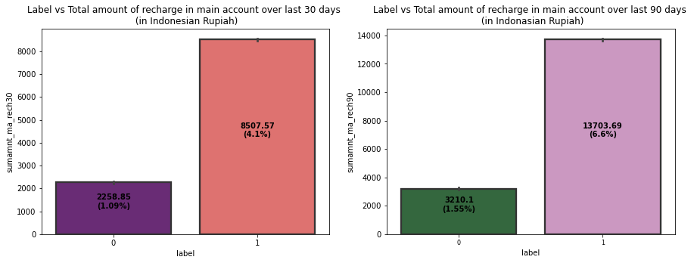
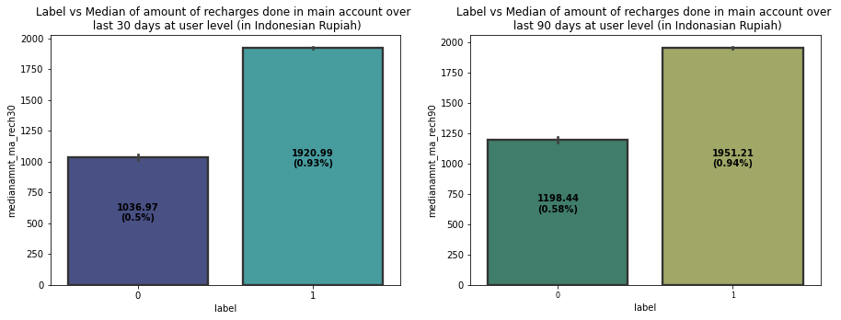
Visualizations: Bivariate Analysis
The users who failed to pay back the loan within 5 days have less amount of recharge in their main account over last 30 days which is around 2000-2400 (in Indonesian Rupiah). And the users who paid back their loan within 5 days, they are recharging their main account more than 8000 (in Indonesian Rupiah) in last 30 days.
The users who have paid their loan amount within 5 days have the total amount of recharge in their main account around 13700 (Indonesian Rupiah) in last 90 days while the defaulters have their total amount of recharge around 3200 (Indonesian Rupiah) over last 90 days.
The users who have done their median amount of recharge of 1920 (Indonesian Rupiah) in main account over last 30 days have successfully paid their credit amount within 5 days of issuing loan while the users who have done amount recharge of 1036 have failed to pay back the loan within due date.
Similar to 30 days data, here also the users who have done their median amount recharge of 1950 in their main account over last 90 days they have paid back their credit amount within 5 days while the users having their median amount 1198 have not paid the loan within 5 days.

Slide 17
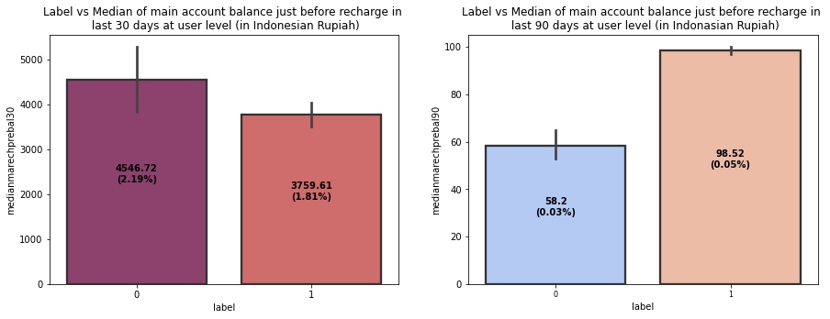
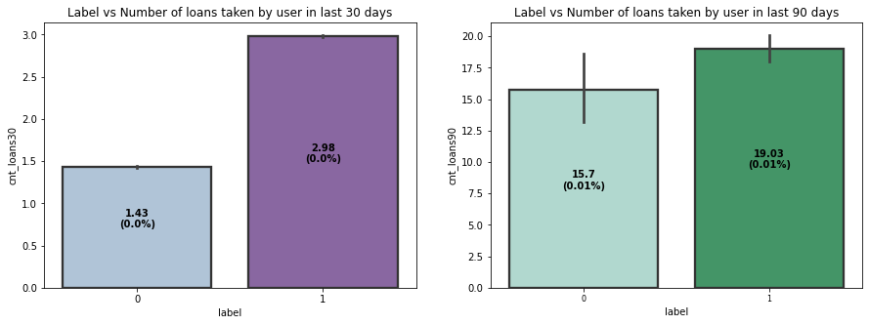
Visualizations: Bivariate Analysis
In 30 days data, the median of main account balance for defaulters are around 4500 (Indonesian Rupiah) which is high compared to non-defaulters. Which means increasing median of main account balance just before recharge in last 30 days at user level, increasing the probability to being defaulter.
In last 90 days data, the median of main account balance for non-defaulters are around 100 (Indonesian Rupiah) which is high compared to defaulters. Which means increasing median of main account balance just before recharge in last 90 days at user level, increasing the probability of being non-defaulters.
Defaulters have taken 1 loan in last 30 days that is when a person takes loan amount for 1 time in last 30 days the chances of not paying back the credit amount are higher. And the users who have paid back the loan, they have taken maximum number of 3 loans in last 30 days data.
In 90 days data, the number of loans taken by the defaulters are highly increasing also increasing the probability to being defaulter. Also, the number of loans taken by non-defaulters being decreased in last 90 days when compared to 30 days data.

Slide 18
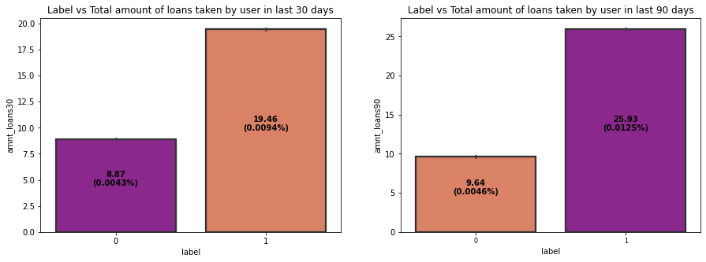
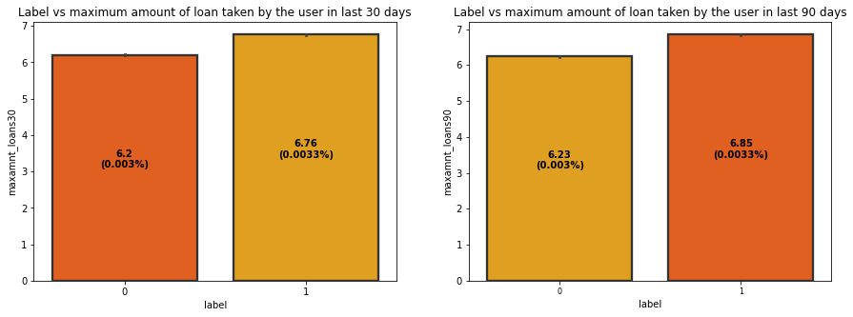
Visualizations: Bivariate Analysis
The total amount of loans taken by the defaulters in last 30 days are in the range of 7.5-10 while the non-defaulters have taken up to 20 loans in last 30 days.
The total amount of loans taken by the defaulters in last 90 days are up to 10 and the non- defaulters have taken total amount of loans up to 26 in last 90 days.
So, from the above plot we can conclude that when the total number of loans taken by the users in last 90 days is below 10, then the chances of not paying back the loan amount are high.
The maximum amount of loan taken by the user in last 30 days and 90 days are almost same. The maximum amount of loan taken by the defaulters and non-defaulters are up to 6 and 7 respectively in last 30 and 90 days.
So from the plot we can say that whenever the user takes the maximum loan amount of 6, then only some users may not pay back the loan amount.

Slide 19
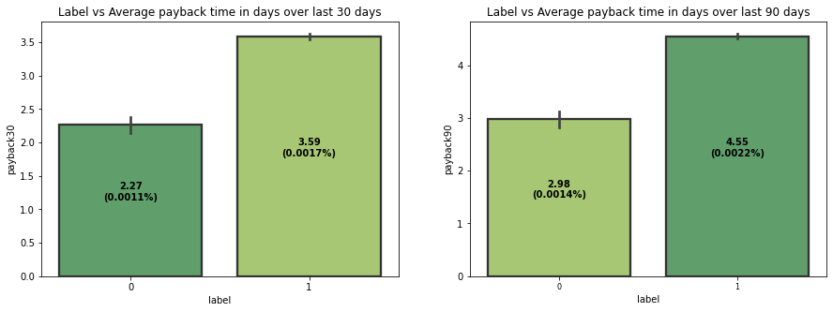
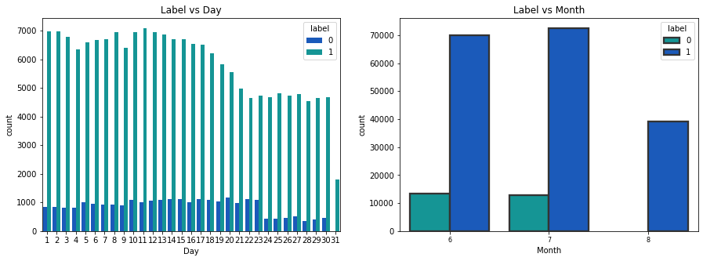
Visualizations: Bivariate Analysis
The defaulters are paying back their loan in an average of 2-2.5 days and the non-defaulters are paying back their loan in an average of 3 days over last 30 days.
The defaulters in last 90 days, are paying back their loan in an average of 3 days and non-defaulters are paying back their loan in 4-5 days over last 90 days.
It is seen from the plot that when an average payback time is below 3 days over last 30 & 90 days, then defaulters' rate is high.
The users who have taken loans in the month of august, they seem paying back their loan within 5 days.

Slide 20
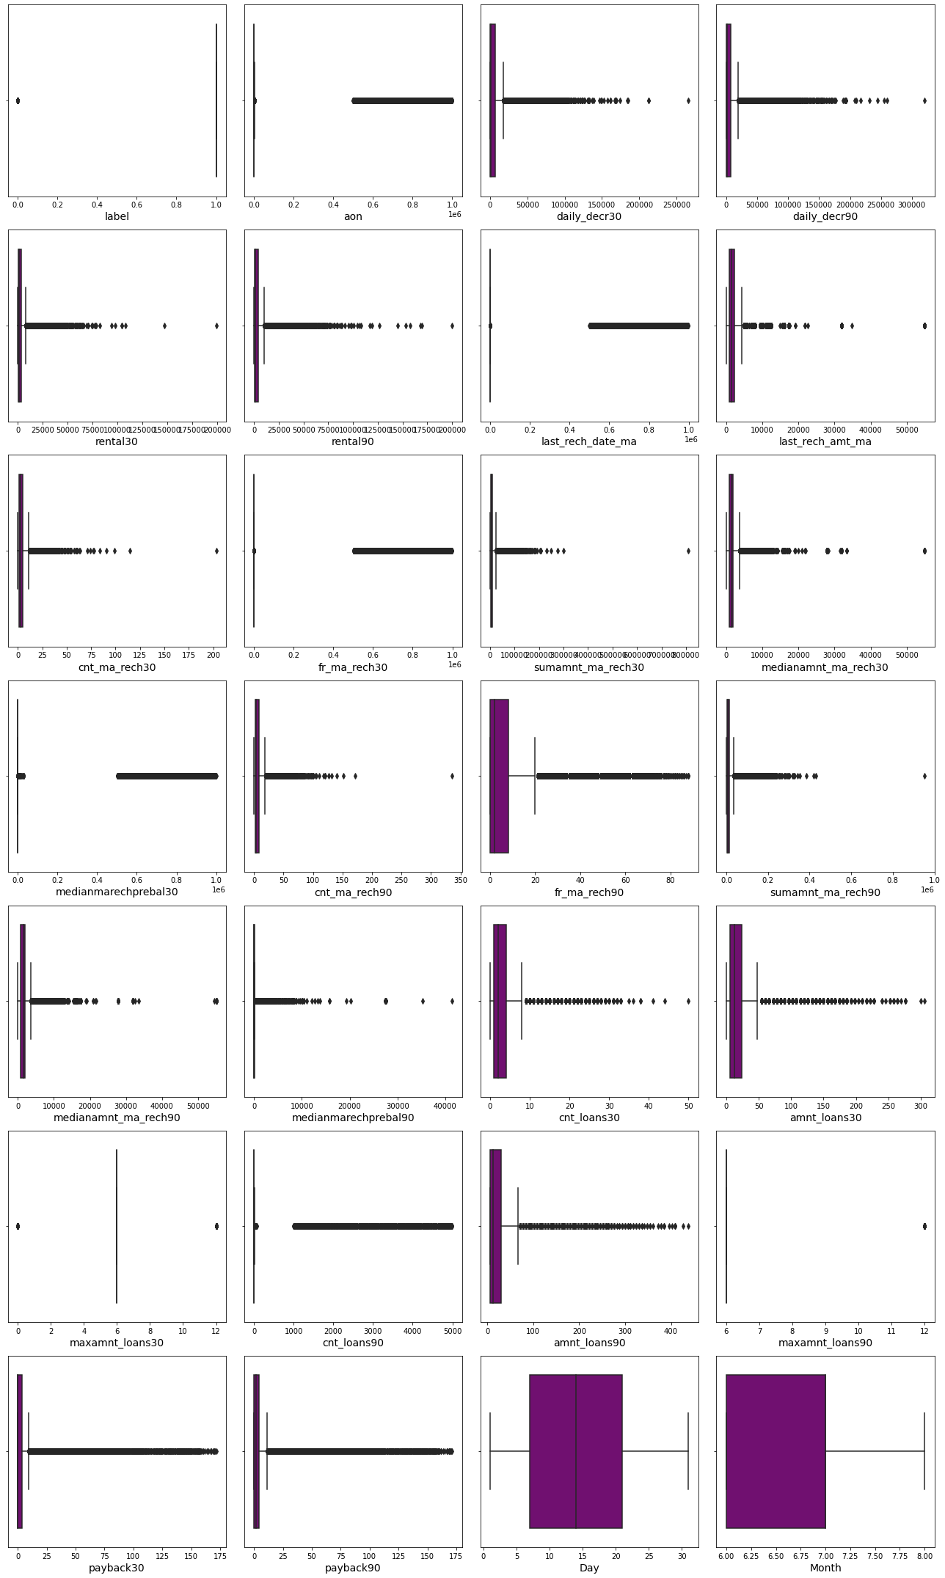
Identifying the outliers using box plot
A box plot is used to summarize data sets by using the box and whisker plot method. This function helps to understand the data summary properly. Box plots can be very useful when we want to know how the data is distributed and spread. Three types of quartiles are used in the box plot to plot the data. These values include the median, maximum, minimum, upper-quartile, and lower-quartile statistical values. A box plot summarizes this data in the 25th, 50th, and 75th percentiles.
From the box plot we can notice the outliers present in all the features except Day and Month columns. I have removed the outliers in these columns using percentile method except Day, Month and label. Since label is our target columns we should not loose any data by removing outliers in this column.

Slide 21
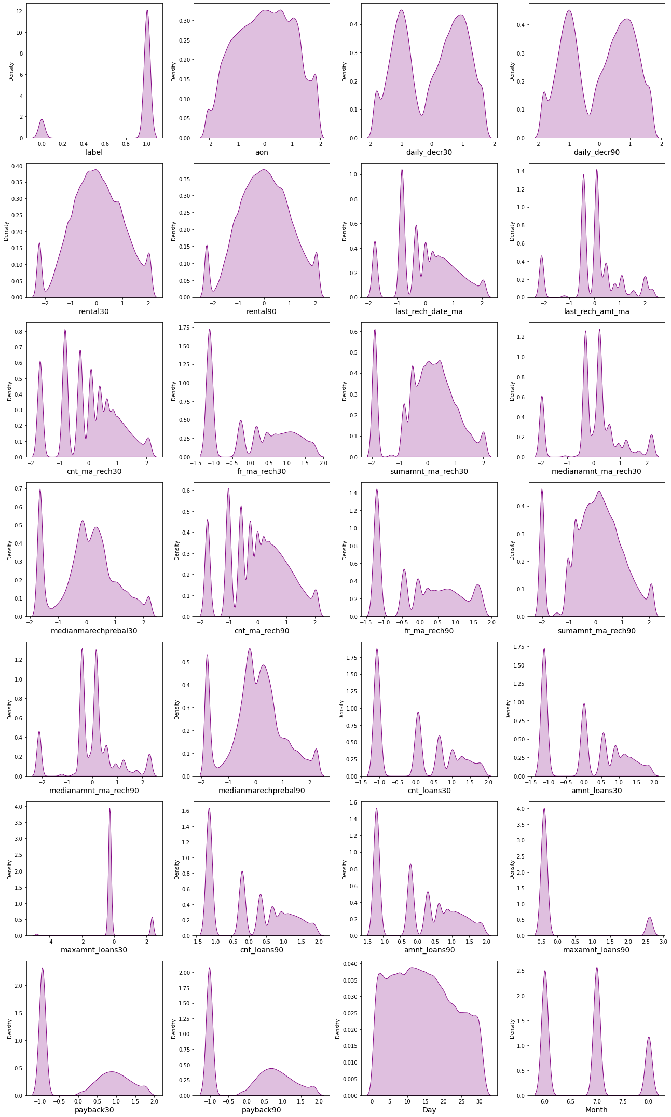
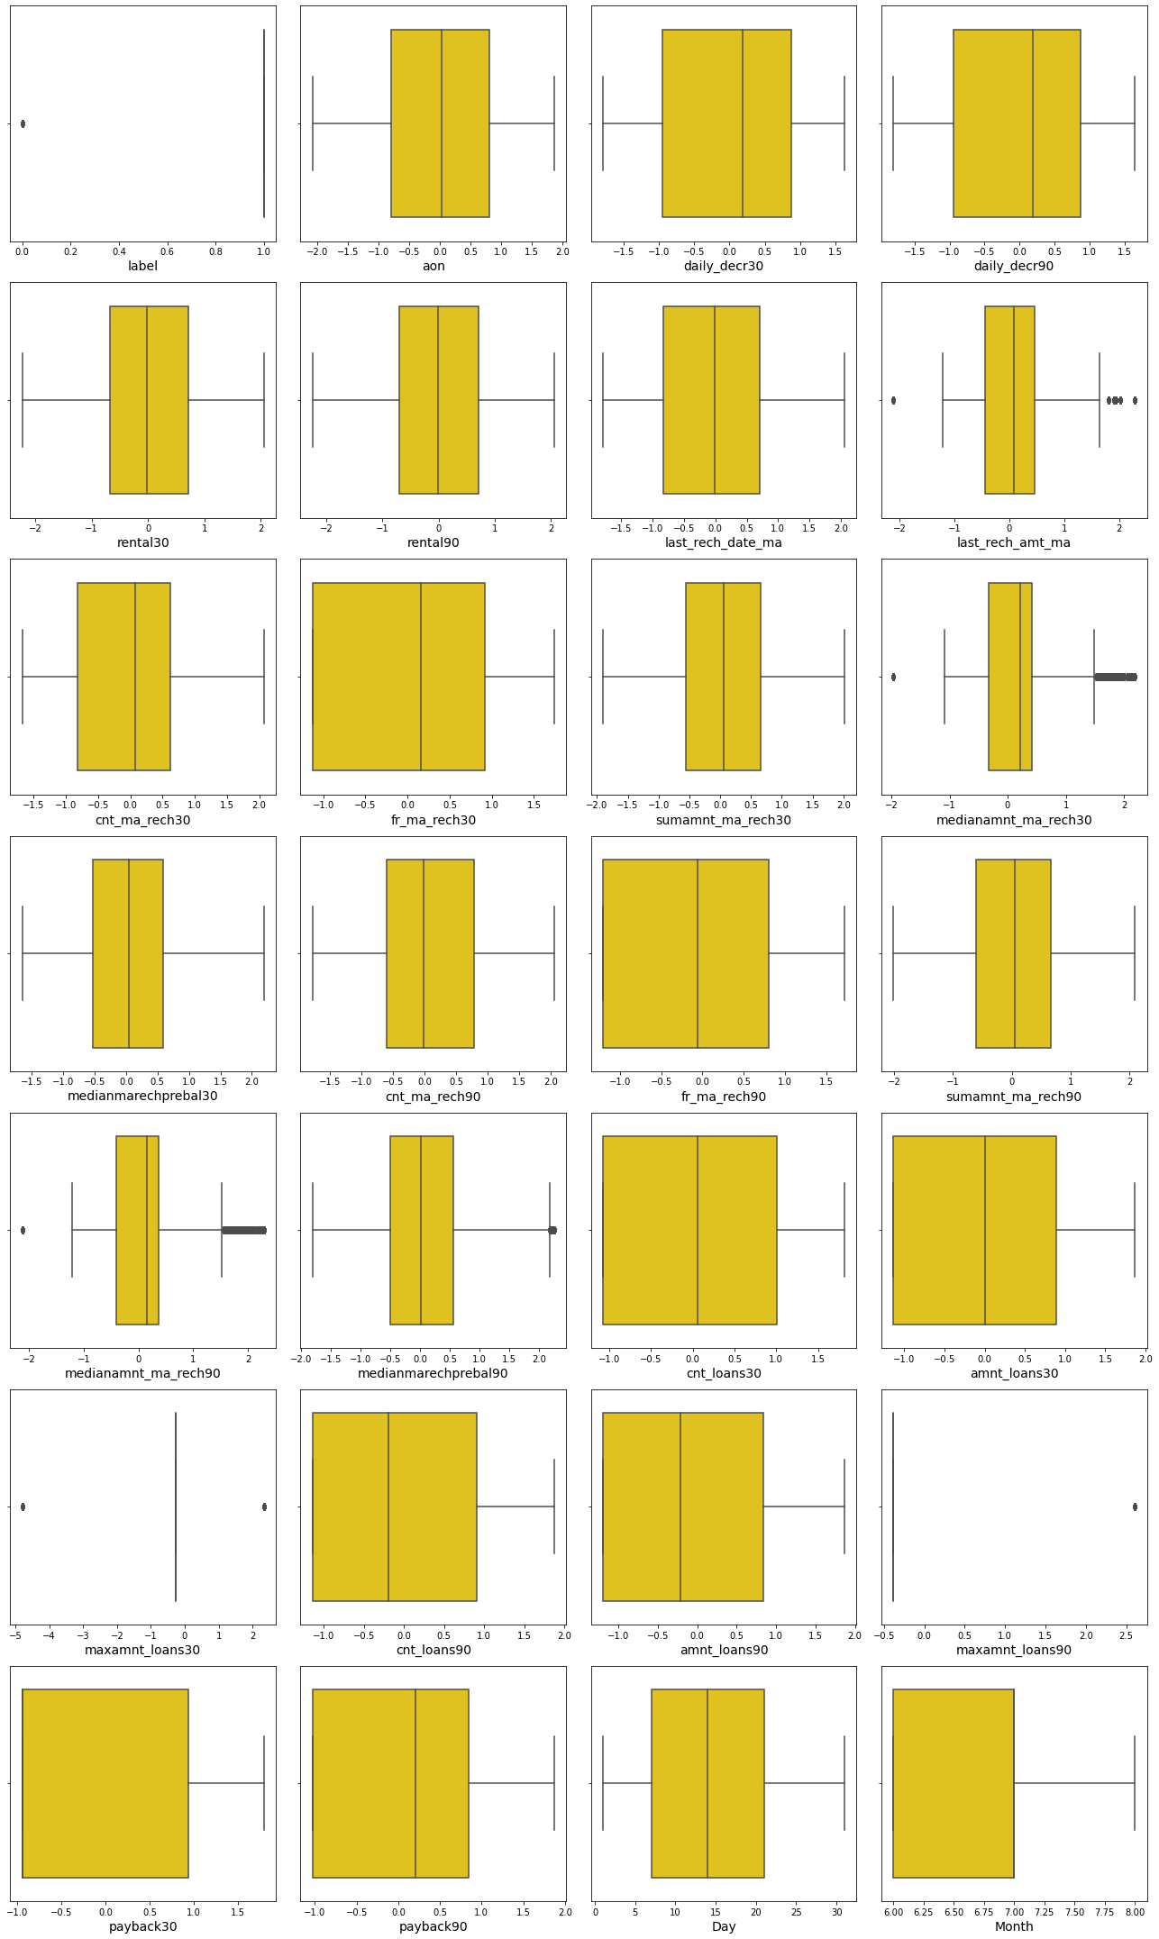
Data After Removing Skewness and Outliers
This is the data after removing outliers and skewness using percentile method and power transformations methods respectively. The data looks almost normal and outliers level also reduced.

Slide 22
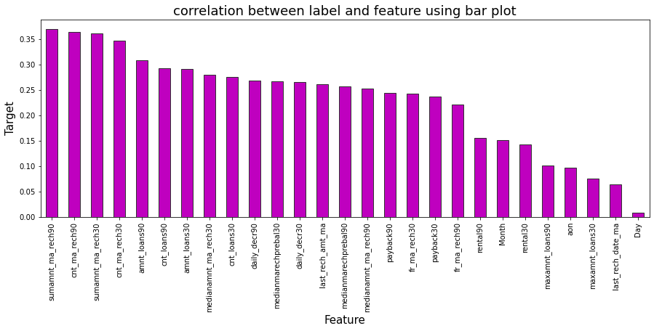
Correlation Between Features and Label
From the bar plot we can clearly observe the positive correlation between the label and features. Here Total amount of recharge in main account over last 30 days is highly correlated with label compared to other features and the column Day is less correlated with the label compared to others .

Slide 23
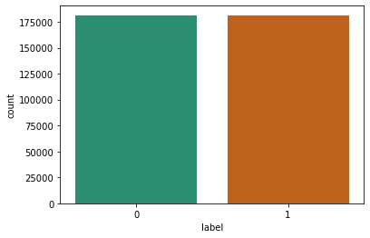
Data Balancing
I have used oversampling (SMOTE) method to balance the data. The obtained output looks like this.
Here we see that we have successfully resolved the class imbalance problem and now all the categories have same data ensuring that the machine learning model does not get biased towards one category.

Slide 24
Data Analysis Steps done
I have done feature engineering steps like feature extraction and feature selection to improve data normality and linearity.
Identified outliers using boxplots and removed outliers using percentile method.
Identified skewness using distribution plots and removed skewness using power transformation method (yeo-johnson method).
Used Pearson’s correlation coefficient to check the correlation between dependent and independent variables. To visualize the correlation I have used heatmap and bar plot.
I have used MinMaxScalar method to scale the data to overcome with the issue of data biasness.
Balanced the data using SMOTE oversampling mechanism.
Split train and test to build machine learning models. Model building process will be shown in the further steps.

Slide 25
Assumptions:
Firstly, from the problem statement we got to know that it is a Classification type problem for which we will be using Classification algorithms to build the model and predict the defaulters level.
Secondly, from the distribution plots and box plots I found skewness and outliers in almost all the columns. Also, based upon the analysis and visualization part we have seen some of the features having linear relation with label. So, I assumed these features helps in model building and to predict the defaulters and non-defaulters level in the organizations. Also, it helps the loan providing companies to give loan to the people who do not have sufficient credit history based on these features.
So, I suggest that the financial institutions take into consideration the features that were deemed as most important as seen in this study might help them estimate the defaulters level.

Slide 26
Model Building:
In this problem label is our target variable which is categorical in nature that is the Label ‘1’ indicates that the loan has been paid i.e., “non-defaulter”, while, Label ‘0’ indicates that the loan has not been paid i.e., “defaulter”. From this I can conclude that it is a Classification type problem hence I have used following regression algorithms.
After the pre-processing and data cleaning I left with 27 columns including target and with the help of feature importance bar graph I used these independent features for model building and prediction. The algorithms used on training the data are as follows:
  Decision Tree Classifier
  Random Forest Classifier
  Extra Trees Classifier
  Gradient Boosting Classifier
  Extreme Gradient Boosting Classifier (XGB)
  Bagging Classifier
I have got the best ransom state and maximum R2 score and then created train test split to build the above models.

Slide 27
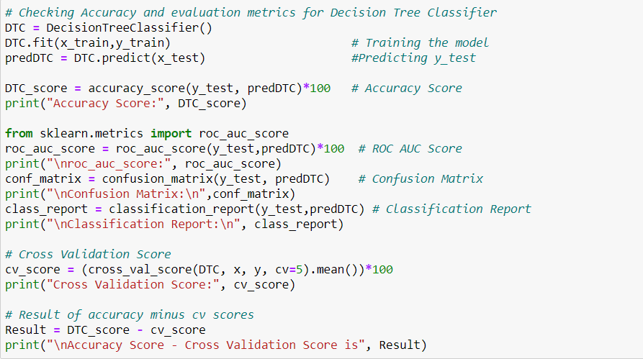
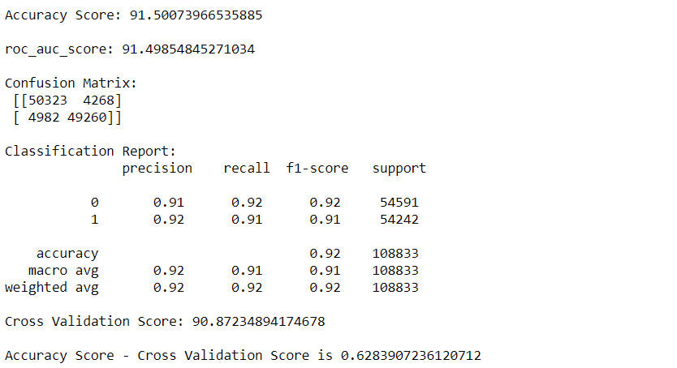
  Decision Tree Classifier
Created Decision Tree Classifier model and checked for its evaluation metrics and it is giving accuracy as 91.50%.

Slide 28
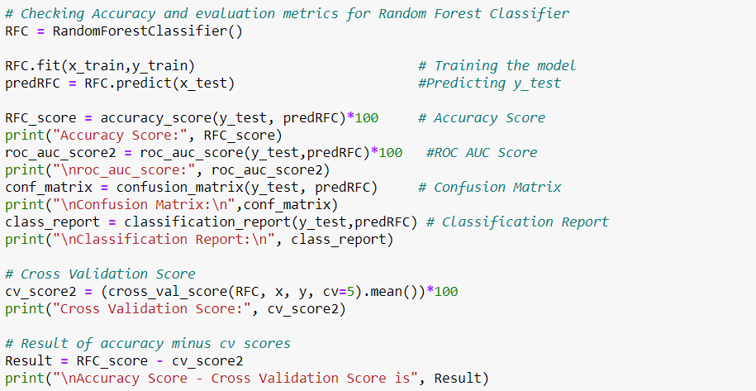
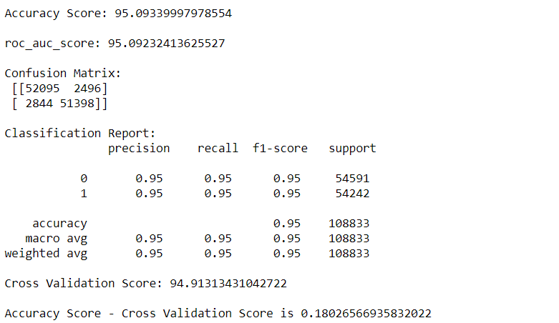
ii. Random Forest Classifier:
Created Random Forest Classifier model and checked for its evaluation metrics. The model giving accuracy as 95.09%.

Slide 29
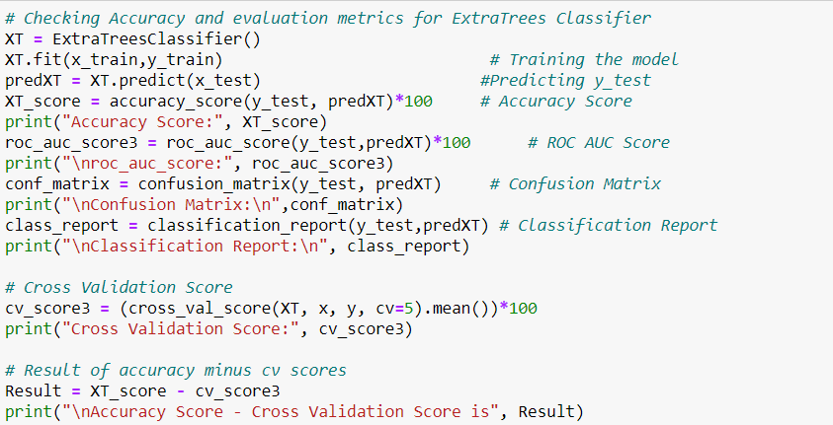
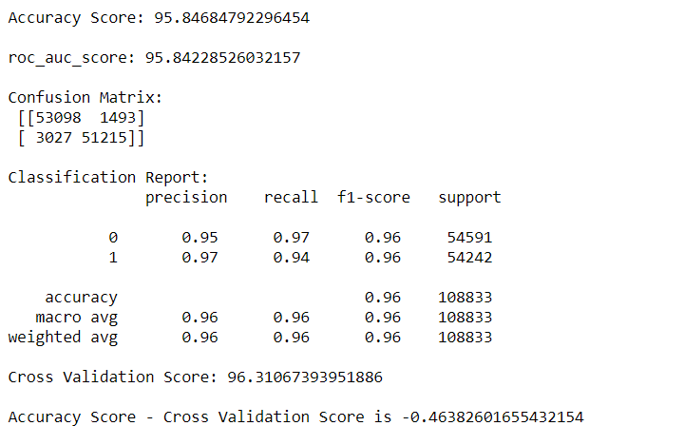
iii. Extra Trees Classifier:
Created Extra Trees Classifier model and checked for its evaluation metrics. The model giving accuracy as 95.84%.

Slide 30
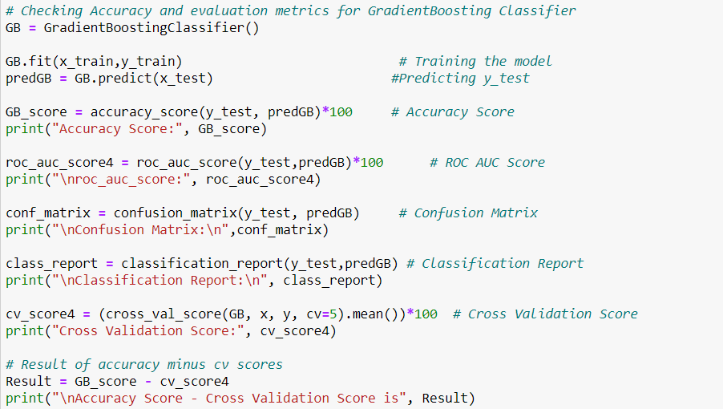
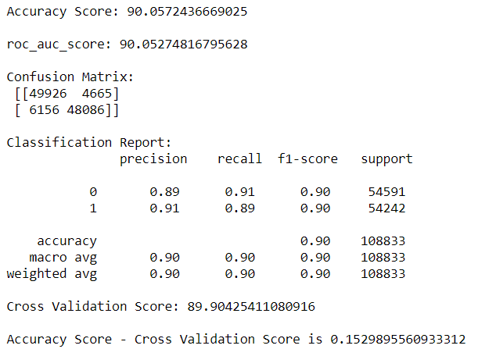
iv. Gradient Boosting Classifier:
Created Gradient Boosting Classifier model and checked for its evaluation metrics. The model giving accuracy as 90.05%.

Slide 31
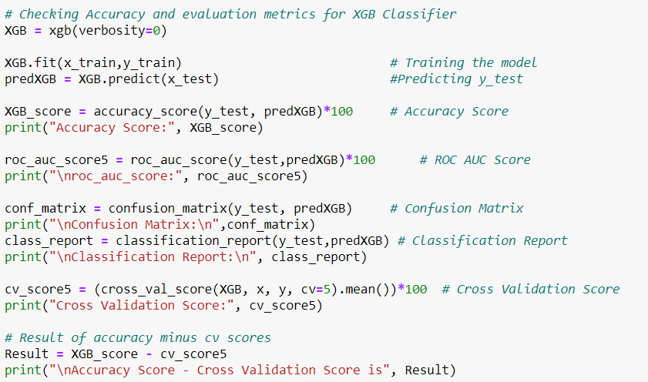
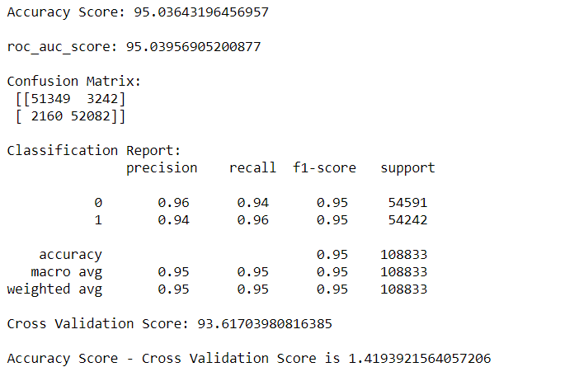
v. Extreme Gradient Boosting Classifier (XGB):
Created Extreme Gradient Boosting Classifier model and checked for its evaluation metrics. The model giving accuracy as 95.03%.

Slide 32
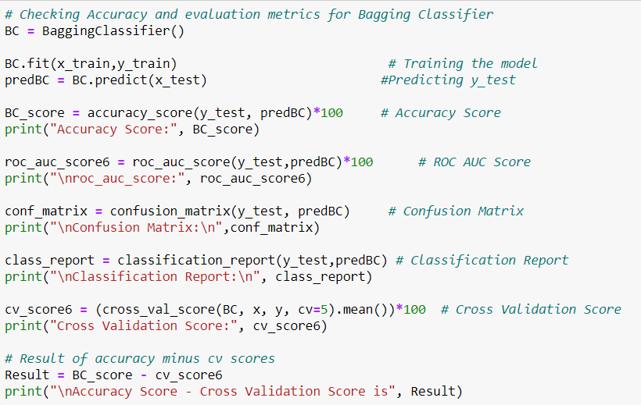
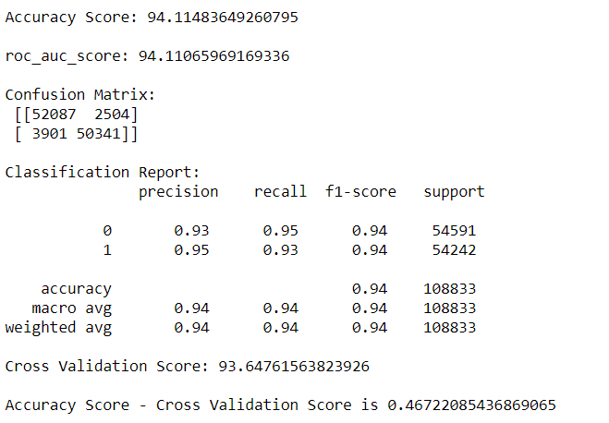
vi. Bagging Classifier:
Created Bagging Classifier model and checked for its evaluation metrics. The model giving accuracy as 94.11%.

Slide 33
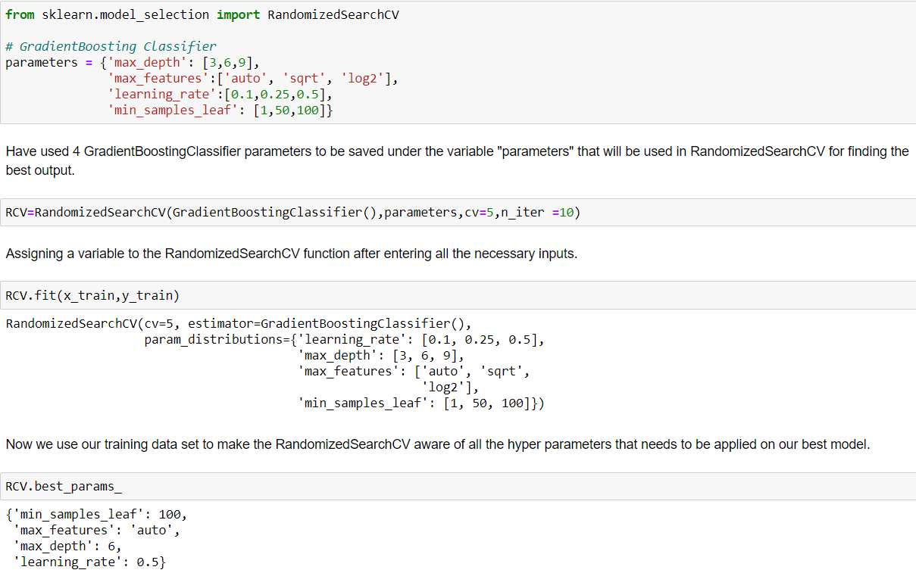
Hyperparameter Tuning:
From the difference between accuracy and cross validation score, Gradient Boosting Classifier has least difference compared to other models. So, we can conclude that Gradient Boosting Classifier as our best fitting model. Performed Hyperparameter tuning to increase the best model accuracy.
I have used RandomizedSearchCV to get the best parameters of Gradient Boosting Classifier. And used all the obtained best parameters to create the accuracy of final model.

Slide 34
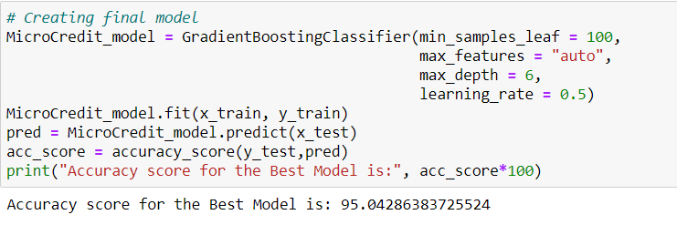
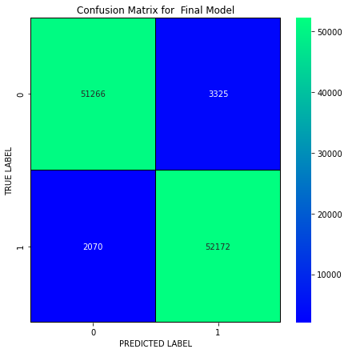
Creating Final Model After Tuning:
I have successfully incorporated the hyper parameter tuning using best parameters of Gradient Boosting Classifier and the accuracy of the model has been increased by 5% after hyperparameter tuning and received the accuracy score as 95.04% which is very good.
With the help of confusion matrix we can able to see actual and predicted values for the final model. And also we can understand the number of times we got the correct outputs and the number of times my model missed to provide the correct prediction

Slide 35
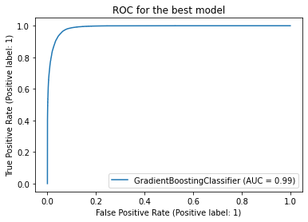
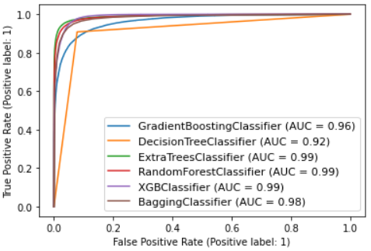
ROC-AUC Curve for all the models and for the best model:
ROC-AUC Curve for all the models
ROC-AUC Curve for final model
I have generated the ROC Curve for all the models and for the best model and compared with AUC. The AUC score for my final model to be of 99% which is increased after tuning the model as it can be observed from the curves.

Slide 36
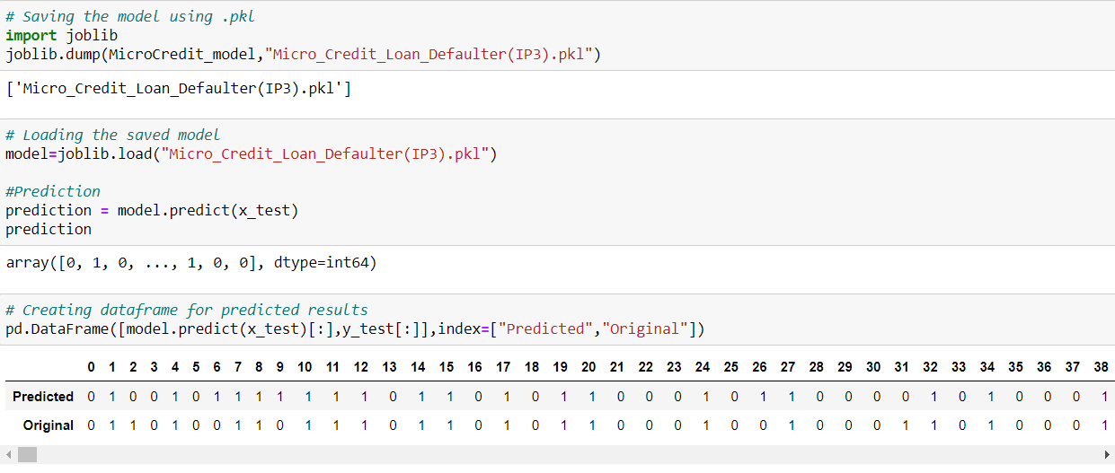
Saving The Final Model And Predictions From Saved Model
I have saved my final best model using joblib library in .pkl format, and loaded saved model for predictions.
Using classification model, we have got the predicted values for micro credit loans for defaulters and non-defaulters. From the predictions we can notice both actual values and predicted values are almost same.

Slide 37
Conclusion:
This case study aims to give an idea of applying EDA in a real business scenario. In this case study, apart from applying the techniques that we have learnt in the EDA module, we will also develop a basic understanding of risk analytics in banking and financial services and understand how data is used to minimize the risk of losing money while lending to customers.
From this dataset we were able to understand that the selection of customers for the credit to know whether they are defaulters or non-defaulters are done on the basis of different features.
First, we loaded the dataset and have done data cleaning and EDA process and pre-processing techniques like checking outliers, skewness, correlation, scaling data etc. And got better insights from data visualization.
Then we did the model training, building the model and finding out the best model on the basis of different metrices like Accuracy Score, Cross Validation Score, roc_auc_score, precision, recall, f1score etc. We tried ensemble techniques like Random Forest Classifier, Extra Trees Classifier, Gradient Boosting Classifier, Bagging Classifier etc. And some other models like Decision Tree Classifier & XGB Classifier.
We got Gradient Boosting Classifier as the best model among all the models as it gave least difference of accuracy and cross validation score. On this basis we performed the Hyperparameter tuning to finding out the best parameter and improving the scores. The accuracy score increased after tuning. So we concluded that Gradient Boosting Classifier as the best algorithm as it was giving high accuracy and AUC after tuning.
After that we saved the model in a pickle with a filename in order to use whenever we require. Then we loaded the saved file and predicted the values.
Overall, we can say that this dataset is good for predicting the defaulters level using classification analysis and conclude that Gradient Boosting Classifier is the best working algorithm model we obtained. We can improve the data by adding some more features.

Slide 38
Thank You

